Slide 1
APPEALS AND YOUR OPTIONS

Slide 4
Narrative

Slide 5
AMA: Decision Review Options
38 CFR 3.2500
Supplemental Claims
Higher Level Review
Board of Veterans Appeals
Claimants can pursue only one decision review option at a time for the same claimed issue
There are no limits to the number of times a veteran may pursue a claimed issue
Notes:
Can keep recycling claim forever theoretically until no new and relevant evidence

Slide 6
AMA Decision Review Options
Claim
Rating Decision issued on or after 2/19/19 or through RAMP
Supplemental Claim
20-0995
Higher Level Review
20-0996
Appeal to BVA
10182
1 year time limit from date of notice of decision for all filing options to protect effective date. Supplemental can be filed anytime but will lose effective date if filed after 1 year.

Slide 7
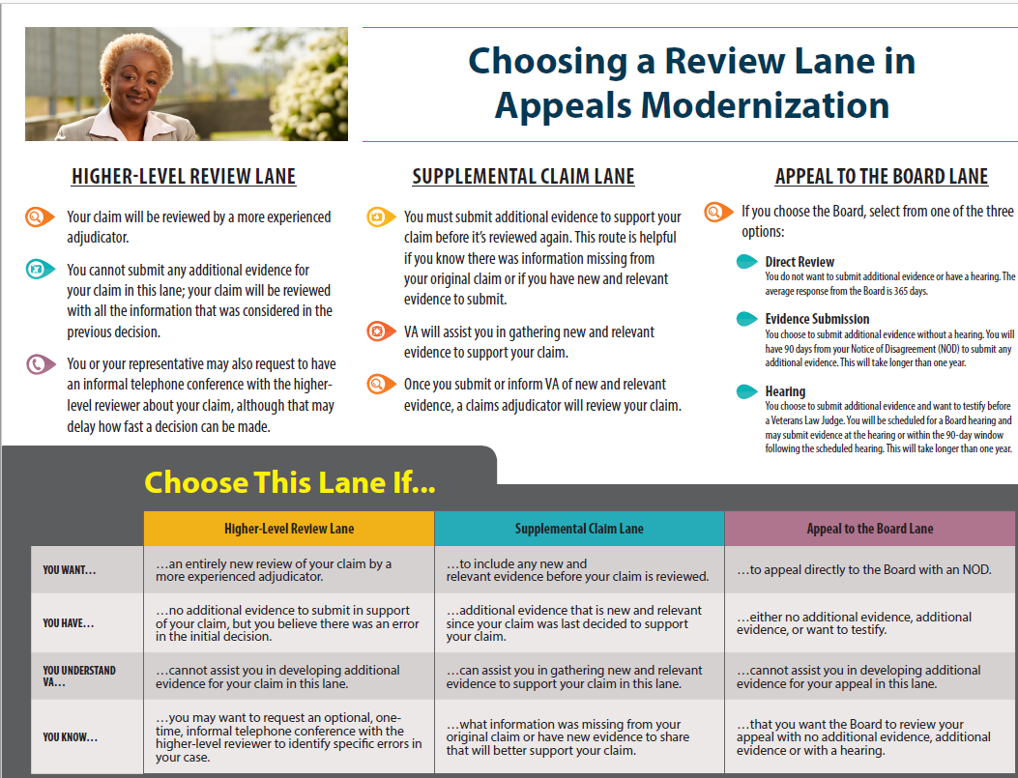

Slide 8
Supplemental Claims: New and Relevant Evidence
What is “New and Relevant?” - 3.2501(a)(1)
“New” means it is not already in the veteran’s claim file
“Relevant” means it is pertinent to the benefit sought and reason benefit was previously denied (even if not favorable to claimant: lower threshold than “material”)
Example:
Red Foreman is claiming his diagnosed ischemic heart disease is the result of exposure to herbicides while serving in Korea in 1970. His claim for service connection was denied because his military service records did not indicate that he served in a unit in or near the Korean demilitarized zone.

Slide 9
Supplemental Claims: New and Relevant Evidence
Disagreeing with a decision is not New and Relevant evidence.
Check the list of evidence. If it is there, it is already a part of the record. If you feel that it was not given the weight that you think it should have, then you want a Higher Level Review.
Remember, when you submit new evidence, a person at the same level that made the previous decision is making the new decision. Only a Higher Level Review will kick it up to someone with more experience.

Slide 10
Supplemental Claims: New and Relevant Evidence
A 4138 with a statement is not new evidence in of itself. It can be if the statement contains new and relevant information.
Quoting a web page in a 4138 is not acceptable new evidence. If you submit the entire web page as a separate document containing its source and references, may be new evidence as long as it is relevant to the case.
Re-labeling evidence with a different title, does not make it new evidence.
Court cases that are precedent setting are already considered when looking at cases. If it is not, it can be brought up but does not need to be followed.

Slide 11
Supplemental Claims: New and Relevant Evidence
Which of these are “New and Relevant?” (assume not in file)
Buddy statements from those who supervised Mr. Foreman while serving in Korea and witnessed him on the DMZ.
Doctor’s notes confirming that Mr. Foreman has a diagnosis for ischemic heart disease
Spouse statement documenting the effects of ischemic heart disease on Mr. Foreman’s daily life
Photos of Mr. Foreman in Korea alongside defoliated areas or signs/landmarks indicating he was physically present at the DMZ

Slide 12
Higher Level Review-20-0996

Slide 13
Higher Level Review-20-0996

Slide 14
Notice of Disagreement- 10182

Slide 15
CHALLENGING A DECISION BY THE BOARD OF VETERANS APPEALS
Appeal to the Court of Appeals for Veterans Claims (CAVC):
120 day deadline from decision notice to file NOA with the Court
Federal Court: service officers cannot represent unless they are also attorneys barred at the CAVC
Suggest veteran obtain veterans benefits lawyer –provide contact info for Bergmann & Moore and Veterans Consortium Pro Bono Program but do not recommend a specific lawyer. Unlike at the VA where lawyers usually charge veteran a fee, many lawyers will represent for free at CAVC – attorney fees paid by government if successful (EAJA)
File a Supplemental Claim at the RO within one year
Effective date may only be from the new claim date. Will be discussed in Appeals Modernization Class.
File a Motion for Reconsideration, Motion to Vacate, or Motion for Revision based on CUE with the BVA
Please consult with VFW’s BVA team regarding this option.

Slide 16
PATHS
If you argue that your case is due to a specific event or exposure, you have to stay with that argument until all appeals are exhausted.
Then if you want to connect it to something else, you can file an 0995 with new evidence.
You cannot pursue both avenues at the same time.
Example: You cannot start a claim saying the cancer is due to asbestos exposure, then during the claim, change and say it was due to benzene exposure.

Slide 17
Conducting a Hearing: During the Hearing
The Dreaded Question:
At the end of each hearing, the hearing officer will always ask if the veteran has anything to add.
This is when many veterans will want to voice their frustration with VA. It is your responsibility to prepare them for this question during your pre-hearing conference and try to prevent this.

Slide 18
Questions?

